Slide 1
Micro Credit Defaulter Project Using Machine Learning Algorithms
Submitted to Fliprobo Technologies
Banglore
Submitted by:- Sujay Nimbalkar

Slide 2


Slide 3
A Microfinance Institution (MFI) is an organization that offers financial services to low income populations. MFS becomes very useful when targeting especially the unbanked poor families living in remote areas with not much sources of income. The Microfinance services (MFS) provided by MFI are Group Loans, Agricultural Loans, Individual Business Loans and so on.
Many microfinance institutions (MFI), experts and donorsare supporting the idea of using mobile financial services (MFS) which they feel are more convenient and efficient, and cost saving, than the traditional high-touch model used since long for the purpose of delivering microfinance services. Though, the MFI industry is primarily focusing on low income families and are very useful in such areas, the implementation of MFShas been uneven with both significant challenges and successes.
Today, microfinance is widely accepted as a poverty-reduction tool, representing $70 billion in outstanding loans and a global outreach of 200 million clients.
We are working with one such client that is in Telecom Industry. They are a fixed wireless telecommunications network provider. They have launched various products and have developed its business and organization based on the budget operator model, offering better products at Lower Prices to all value conscious customers through a strategy of disruptive innovation that focuses on the subscriber.
They understand the importance of communication and how it affects a person’s life, thus, focusing on providing their services and products to low income families and poor customers that can help them in the need of hour.
They arecollaborating with an MFI to provide micro-credit on mobile balances to be paid back in 5 days. The Consumer is believed to be defaulter if he deviates from the path of paying back the loaned amount within the time duration of 5 days. For the loan amount of 5 (in Indonesian Rupiah), payback amount should be6(in Indonesian Rupiah), while, for the loan amount of 10(in Indonesian Rupiah), the payback amount should be 12(in Indonesian Rupiah).
The sample data is provided to us from our client database. It is hereby given to you for this exercise. In order to improve the selection of customers for the credit, the client wants some predictions that could help them in further investment and improvement in selection of customers.

Slide 4
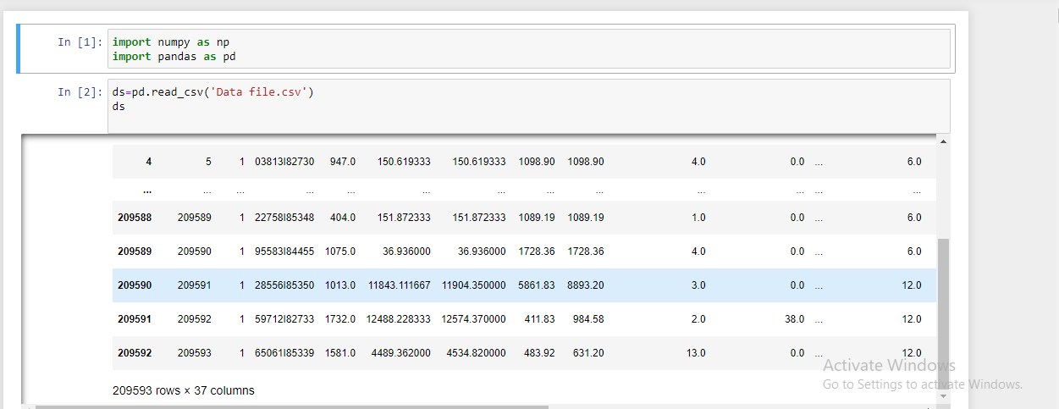
Importing all the necessary libraries and loading the data set

Slide 5
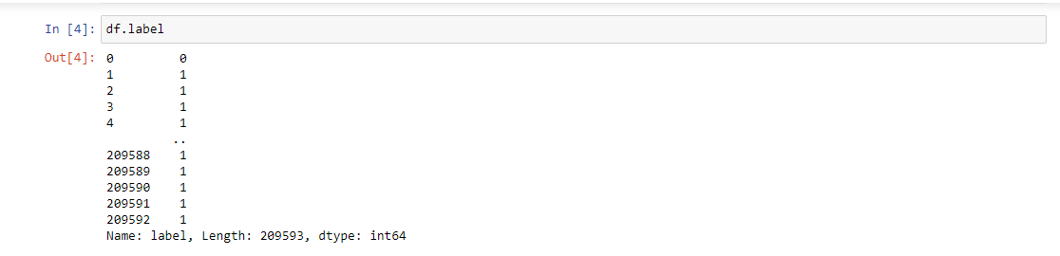
Now we have identified the problem looking at the data set, hence from the below picture you can clearly see that the problem is of logistic regression problem and label is dependant variable target

Slide 6
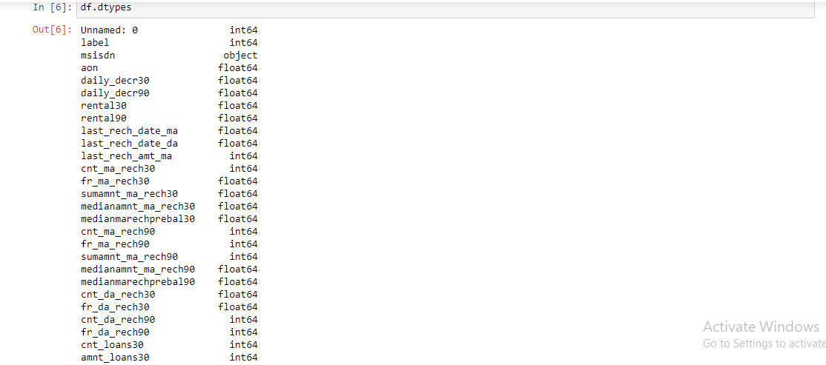
Below picture is showing the Data type

Slide 7
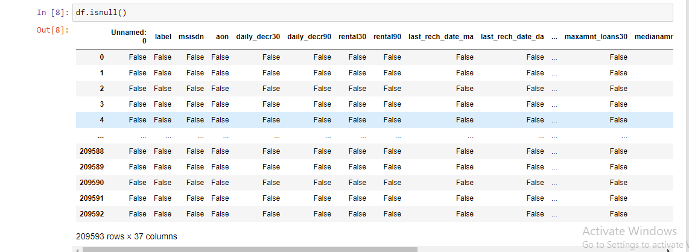
We have checked the Null values in the data set using is null function

Slide 8
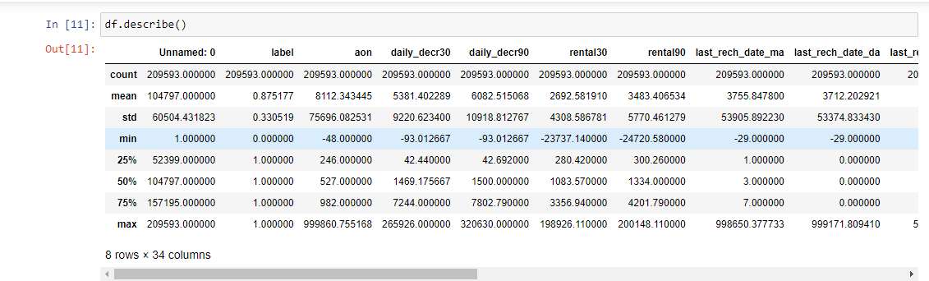
Below is Description of the Data set

Slide 9
Key observations
1 we can see the huge difference between the range of data of all the columns.
2 we can see the huge difference in 50% percentile and mean .
3 There is a large difference in 75% percentile, which shows the extreme outliers present in many columns like
aon,daily_decr30,daily_decr90 etc.
4 There is a small difference in 75% percentile in Unnamed column which shows that their are no outliers
-->By observing the above points we can see that their are extreme outliers in the data,due to this
skewness is also present ,and their is huge difference between the range of each column.

Slide 10
Again importing all the necessary libraries
import seaborn as sns
import matplotlib.pyplot as plt
from scipy.stats import zscore
from sklearn.linear_model import LogisticRegression
from sklearn.naive_bayes import GaussianNB
from sklearn.ensemble import RandomForestClassifier
from sklearn.ensemble import AdaBoostClassifier
from sklearn.metrics import accuracy_score,confusion_matrix,classification_report
from sklearn.preprocessing import StandardScaler
from sklearn.model_selection import cross_val_score
import warnings
warnings.filterwarnings('ignore')

Slide 11
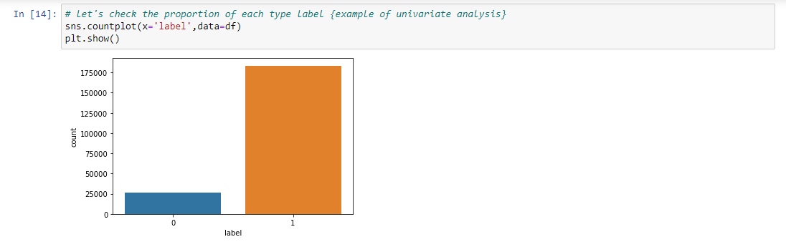
Checking the imbalance in our data set so the below picture resemble the imbalance in the data set

Slide 12
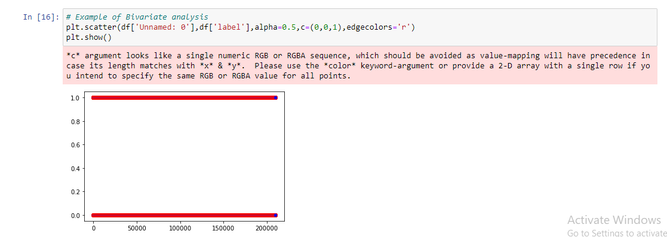
Below is the example of Bivariate analysis we have plotted scatter plot

Slide 13
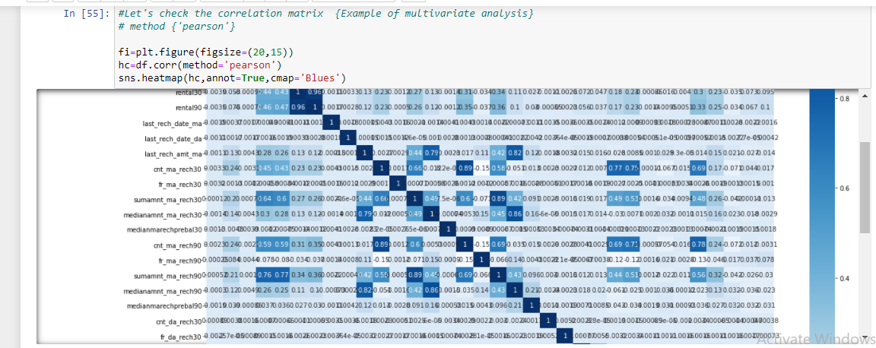
Example of Multivariate analysis Here we will check the co relation matrics by plotting heat map

Slide 14
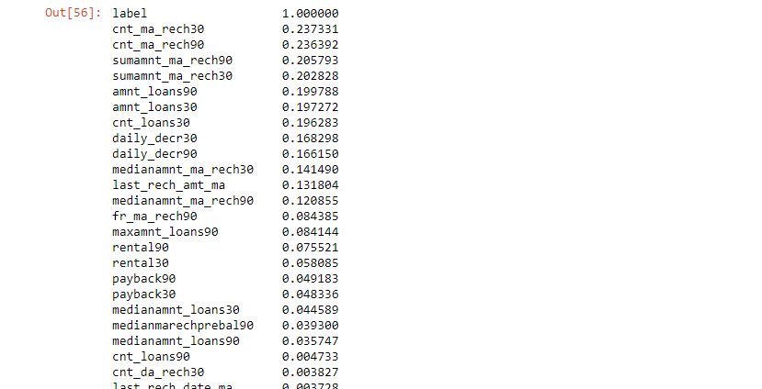
hc['label'].sort_values(ascending=False)

Slide 15
Observations:
Now we can clearly identify the correlation of independent variable with target variable "label" .The variables who has values less than 0.01
correlation value(very week relationship).

Slide 16
Label Encoding
After label Encoding the column is totally converted into the integer format.
So we have to apply Label encoding on the whole dataset, because some values seems are not realistic ,so just to deal with them.
we apply Label encoding on the whole dataset.

Slide 17
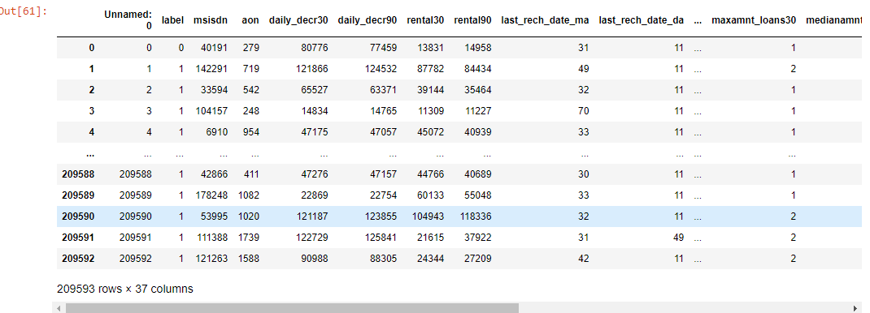
Below picture represents after label encoding

Slide 18
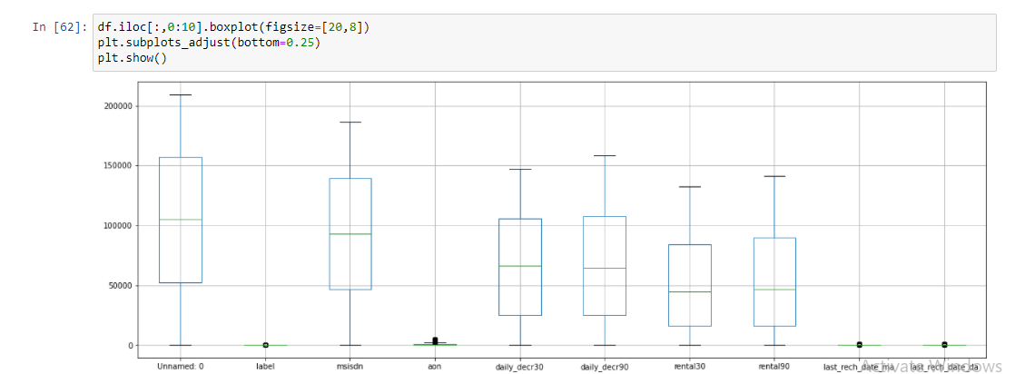
Checking for outliers

Slide 19
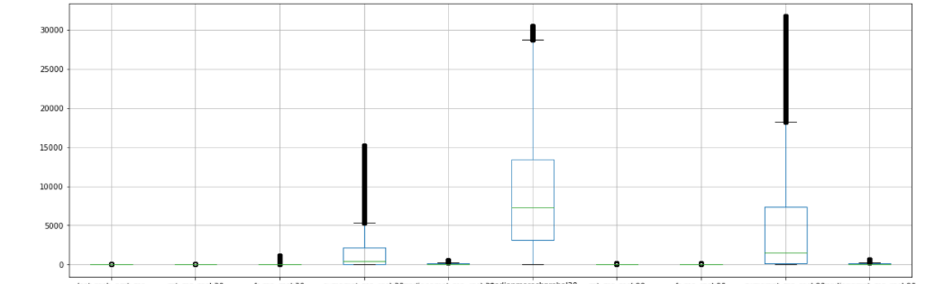
df.iloc[:,10:20].boxplot(figsize=[20,8]) plt.subplots_adjust(bottom=0.25) plt.show()

Slide 20
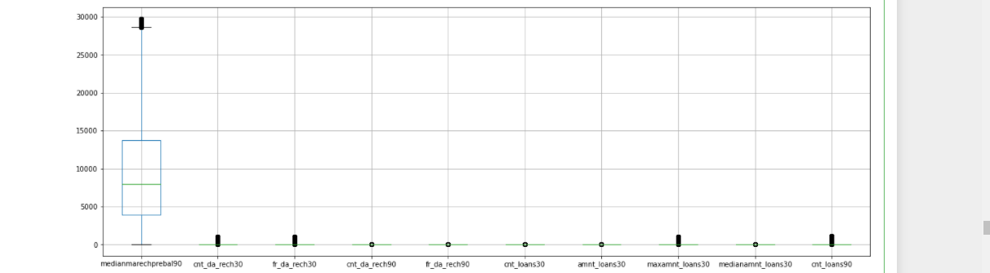
df.iloc[:,20:30].boxplot(figsize=[20,8]) plt.subplots_adjust(bottom=0.25) plt.show()

Slide 21
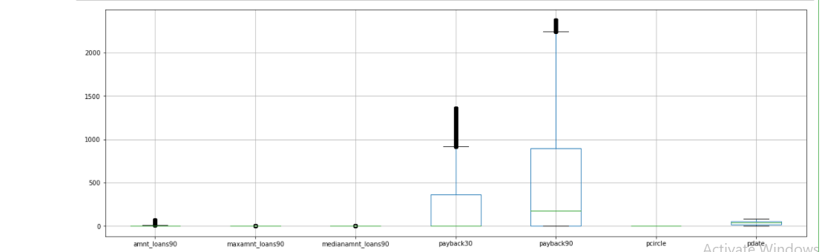
df.iloc[:,30:37].boxplot(figsize=[20,8]) plt.subplots_adjust(bottom=0.25) plt.show()

Slide 22
Observations:-
We are losing high data while removing the outlier .so we are not going to implement any method to remove oultier So when we remove skewness outliers will also removed.

Slide 23
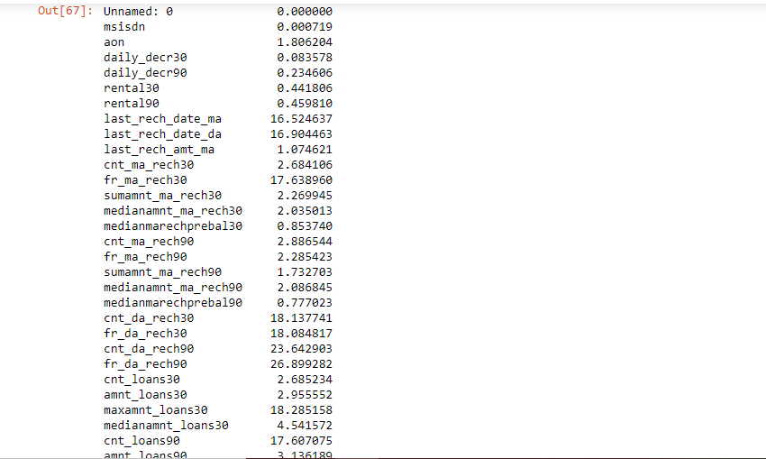
Separating independent variable and target variable.

Slide 24
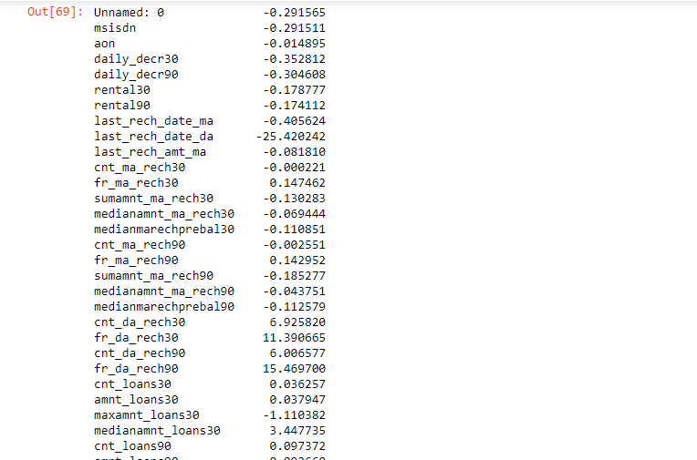
from sklearn.preprocessing import power_transform df_new=power_transform(x1) df_new=pd.DataFrame(df_new,columns=x1.columns) Here we can see that the skewness has been removed

Slide 25
We have scaled the data using standard scaler,Now we have handled the class imbalance problem with oversampeling with the minority class.
Creating train_test_split method we got the best accuracy score of 0.7728309361342552

Slide 26
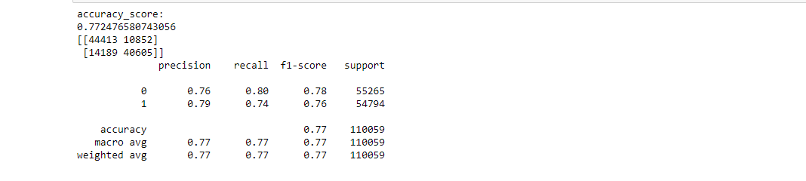
Finding the best algorithm using multiple models 1.Logistic Regression

Slide 27
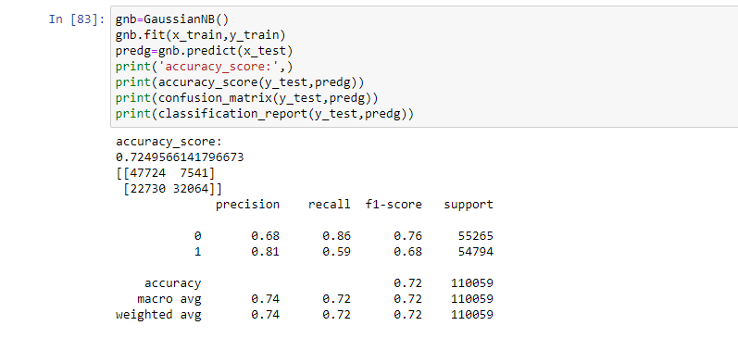
With GaussianNB

Slide 28
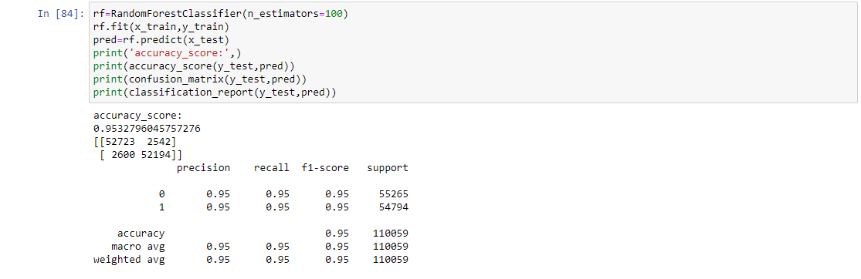
With RandomForestClassifier

Slide 29
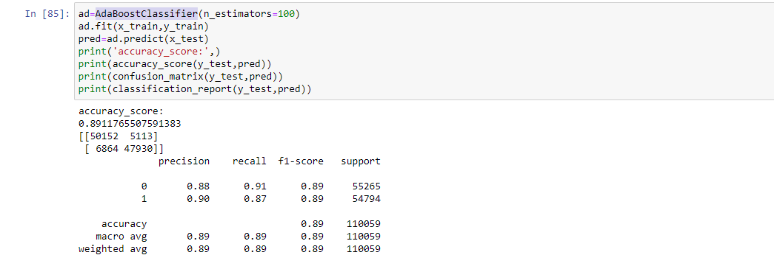
With AdaBoostClassifier

